Slide 1
Lab Entry

Slide 2

Team Members
Gourav Sharma (Team Lead) - 2147486898
Rohini Holebenavalli Jagadeesh
(UI/UX Designer) - 218053094
Bala chand Tipirneni (Developer - B) - 217334617
Jitender Varma Vejella (Developer - F) - 217055372
Wenbo Wu (Product Owner) - 215036415

Slide 3
Project Goal
The Project goal is to create an application preferably a mobile app which will show the details of completion of required safety unit to enter into the laboratories.

Slide 4
Project Description
Student eligibility
Reminding about the unit
Attendance Check
If the student hasn’t finished the unit, it automatically sends the reminder about the completion to their emails.
The basic idea of the project is to check if the student has completed the pre requisite unit to enter into the laboratory.
Also, this application allows the faculty to look upon the attendance percentage.
3
1
2

Slide 5
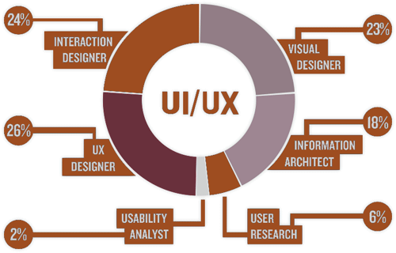
Web Designer
Creating page by page interface of the application.
Creation of App roadmap.
The above setup requires performance of a UI/UX designer.

Slide 6
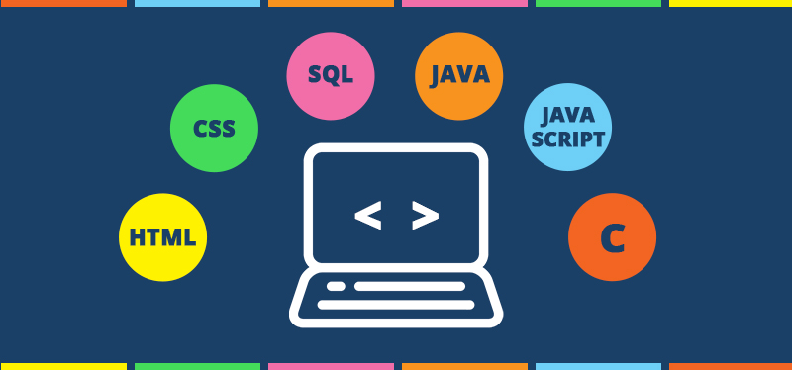
Web Developer
Database setup, the details of all the students
Server side setup.
Utilizing the framework to create a mobile web application.
The above setup requires a front end developer and a back end developer to perform.

Slide 7
Stages of processing
Enter Details:
Enter Student ID
Select Unit
Unit completion status:
Completed Successfully
Not Completed
Student Details:
Name:
ID:
Unit:
Completion Date:
Session allotted:
2133455
Next Step
Next Step
OR
RDIT
Enter
Details
This page allows to enter the student details or swipe the student ID card followed by selecting the unit name.
In the next step the input data will be processed through some database check up and outputs information regarding the completion of unit.
In the next window, full details of the student will be provided.

Slide 8
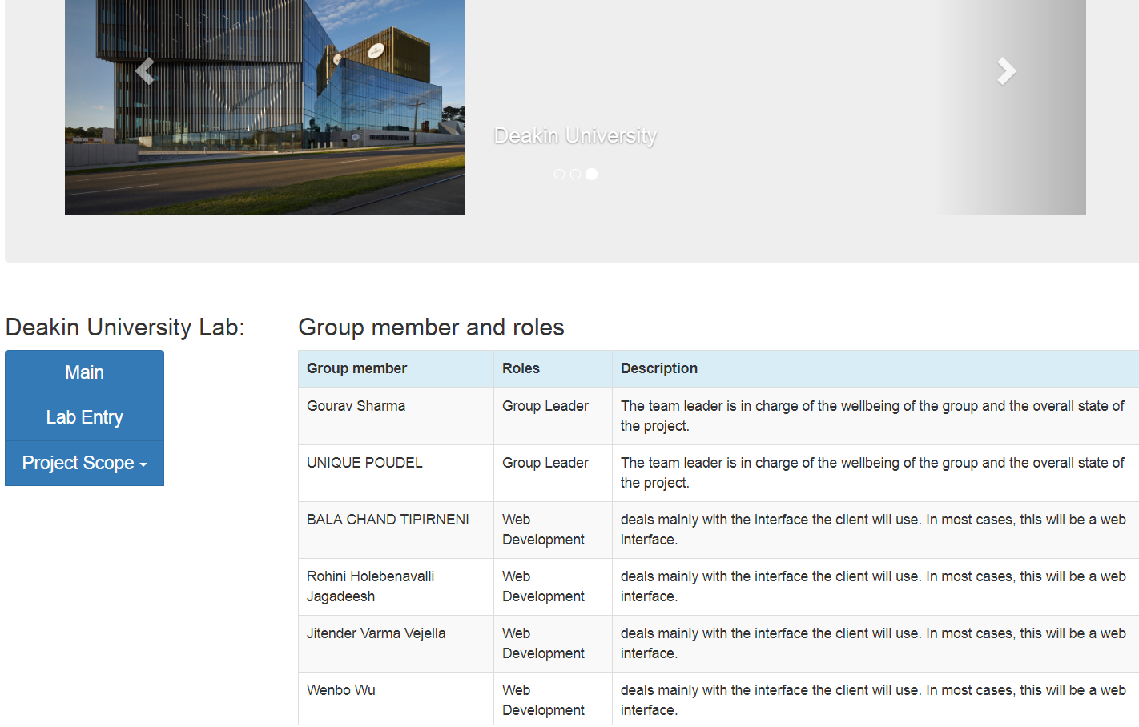
Website Screenshot

Slide 9

Future Plans
This application can be transferred into a device feature which will scan the student card and let the student to enter the lab if the unit has completed.
More modern features can be added.
If well developed, might be proposed to other universities.

Slide 10
Thank You

